Slide 1



LESSON 3
Gear Up for Career Success
Get Ready for a Hands-on Experience
Notes:
Materials needed for Lesson 3
Lesson 3 PowerPoint
Lesson 3 Teacher Notes
SCK LAUNCH Video
Small Slips of Paper
Note card
Teacher Notes
Talking Points:
Today we are going to prepare for the career event by reviewing the sectors and preparing questions to ask representatives from the businesses you will visit during the Experience.
By asking questions at the event, you might earn some cool swag and gain powerful insight from people in career fields that you’re interested in.

Slide 2


In today’s lesson, we will…
Prepare for attending the Experience event
Learn that this is more than a field trip. This event is to help students begin to learn how to become more career focused.
Write 3 to 4 open- ended question to use at the event.
Notes:
Teacher Notes:
Suggested Strategy: Have one student per table group read one lesson objective aloud for the group.
Talking Points:
In today’s lesson, we will do three things to help us prepare for the SCK LAUNCH Experience event.
We will prepare to attend the event.
We will learn that this is so much more than a “field trip.” You’re going to learn how to become more career-focused!
We will also write 3-4 open-ended questions that you can use Experience to help you gain more insight into careers you’re interested in.
Plus, how to earn cool swag at the event by doing so!

Slide 3

This is not a regular field trip
This is an experience!
How does the day work?
Entrance – You will be handed a cinch bag with important information to help you navigate the experience
Four Zones – You will visit four zones and have approximately 25 minutes in each zone
Music – Listen for the music! That means you’re about to move into a new experience zone
Talk to Businesses for Swag - Using the open-ended question you create today, you will earn cool swag by engaging with local businesses
Notes:
Teacher Notes:
Talking Points:
So how does the SCK LAUNCH Experience work?
When we get to the Experience, you will be given a cinch bag that has very important information inside to help you navigate the event and give you more career information.
You will visit four different zones throughout Experience.
The seven sectors we have learned about will be combined into four zones.
You will have 22 minutes in each zone, so use your time wisely and make sure you visit each sector within the zones.
While at these zones, you will talk with people who work in these career fields everyday.
Listen for the music, when you hear loud music playing, that means it is time to travel to the next zone. Follow the SCK LAUNCH Experience workers as they guide you into your next zone. They will all be in the same color volunteer shirt that says SCK LAUNCH on the front.
You will earn awesome swag from these local businesses by engaging them in conversation centered around their career - we will prepare those questions today.

Slide 4







Sectors
At the Experience, you will meet people who can answer your questions about their work experience in these Sectors.
Notes:
Teacher Notes:
Talking Points:
Let’s take a moment to remember the 7 sectors. There will be companies from each sector at the event.
Ask students questions about each sector.
What is one thing that people do in each of these sectors?
What do you remember about the high demand and hard to find careers in each?
What else do you remember?

Slide 5

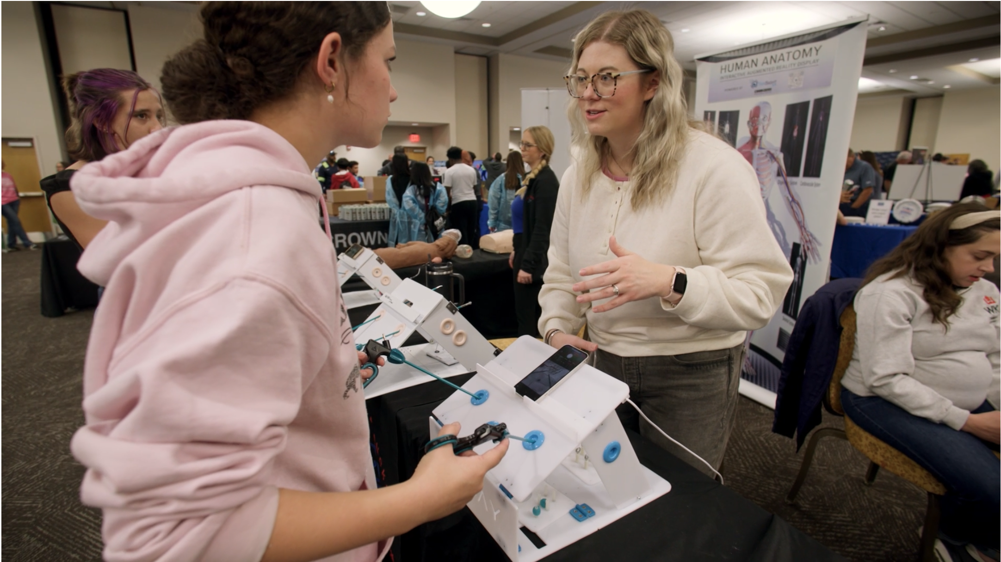
Notes:
Teacher Notes:
Materials needed: pull up this video https://scklaunch.com/sck-launch-experience/
Talking Points:
Here is a video to help you visualize what the SCK LAUNCH Experience is like.
This event is for 8th graders only all across South Central Kentucky. 3500 students will attend over two days.
So, remember when we attend, we will be there with other middle school students.

Slide 6




WRITE
Step 1 Pick one or two of the Sectors that interests you most.
Step 2 Then using the slips of paper provided, jot down 1 question at a time that you would like to ask a person in that sector.
Step 3 Place that question face down in the center of your table.
Step 4 Repeat until time is up.
Remember - these need to be open-ended questions.
That means the answers to these question should not be yes or no.
Notes:
Teacher Notes:
Materials needed: Small Slips of Paper
Suggested Strategy: Jot Thoughts
Teacher provides students with a question or prompt
Students use slips of paper provided to answer the question (one answer per slip of paper)
Place slips of paper face down in the center of the table. Repeat!
The goal is to cover your table with as many answers as possible.
Talking Points:
We are going to practice having conversations and asking questions, so you are ready for Experience. Companies will have ‘swag’ with their company logo and information about who they are and what they do. To get this ‘swag,’ you must have a conversation with people at the company table.
We are going to prepare the open-ended questions today so you’re ready for Experience.
Using the slips on paper on your desk, write one open-ended question at a time and place the question face down in the center of your table.
Then grab another slip of paper and write another open-ended question you could ask career representatives to learn about their career, their day-to-day job, how they got the job, etc.
Repeat this process until the time is up. When you’re done, your table will have a pile of questions you can use at the experience to help you earn swag!

Slide 7





Sample Questions:
What kind of problems do you deal with at work?
Why did this type of work interest you?
What did you do before this occupation? Was it helpful?
What else could you do with your education/experience?
Why did you choose to work for this company?
How does a person progress in this field?
What skills are most important?
Using your notecard, look at the questions from Jot Thoughts and the examples of the board.
Choose 3-4 questions you think would be good questions to use
at the Experience and write
them down on your notecard.
Notes:
Teacher Notes:
Materials needed: Index Card for Student Final Questions
Talking Points:
Now each of you need to write the questions that you will use to have your conversations during the event.
Here are a few ideas to help you! Using the jot thoughts you just filled your desk with and these examples, choose 3-4 that you think would be best for you to use at the Experience.
Take 4 minutes to silently complete this task. Write down your 3-4 questions on your provided note card so you’re ready for the closing activity.
Remind students: It is important to take every opportunity to have a conversation with the people working at the event. They are there because they want to share what they do. And what their business does.

Slide 8


The students walk around the classroom until the teacher calls “pair.” Students then turn and find a partner near them.
Teacher creates questions for students to answer.
Students get up and walk around the classroom.
Teacher calls “Pair.”
Students partner up with the student closest to them.
Teacher asks questions to students and gives them level zero think time before answering.
Students share with partners by taking turns.
Notes:
Teacher Notes:
Materials needed: Completed Index Card
Recommend Strategy for Closing Activity: Mix-Pair-Share
Teacher creates questions for students to answer
Students get up and walk around the classroom
Teacher calls “Pair”
Students partner up with the student closest to them
Teacher asks questions to students and gives them level zero think time before answering
Students share with partners by taking turns
Talking Points:
In our closing activity today, you will work on Employability Skills such as Eye Contact, Hand Shakes, Volume, & Verbal Communication.
Using the note card you have 3-4 questions on, you’re going to practice asking questions and using employability skills with your classmates.
We will use the Mix-Pair-Share strategy to practice.
When instructed you will walk around the room with your notecard until you hear me call - “Pair.”
Then, one at a time, shake your partner’s hand, use good eye contact, and use an appropriate voice level to ask one of your prepared questions.
Once you’re done - switch so your partner can practice. We will repeat this multiple times so you can get practice asking all of your questions.

Slide 9

PRACTICE
Practice shaking hands and asking the three questions that you will ask a career representative at Experience - you can use the questions from Jot Thoughts!
Remember - The experience will be loud, so use need to use an appropriate voice level in order to ask the career representatives these questions. Practice that today with your partner!
Notes:
Talking Points: Close out the lesson with any reminders about the field trip and expectation.

Slide 10


“I never learn anything talking. I only learn things when I ask questions.” — Lou Holtz

