Slide 1



LESSON 2
Unlock Your Future
Explore your Interests and Careers
Notes:
Materials needed for Lesson 2
Lesson 2 PowerPoint
Lesson 2 Teacher Notes
Internet Access to O-Net Interest Profiler
Career Interest Graphic Organizer
Internet Device for Each Student
Piece of paper per student
Teacher Notes:
Talking Points:
We will continue with lesson two, “Unlock Your Future: Explore Your Interests and Careers”.

Slide 2

In today’s lesson…
Define personal interests and their relevance to future career paths
Connect personal interests with available school resources
Acquire essential career-related vocabulary
Investigate specific aspects of chosen career interests such as education requirements, salary ranges, and potential employers
Notes:
Teacher Notes:
Materials needed:
Suggested Strategy: Have one student per table group read one lesson objective aloud for the group.
Talking Points:
In today’s lesson we will explore your own interests.
We will define personal interests and their relevance to future career paths.
You will then connect personal interests with available school resources; acquire essential career-related vocabulary; and investigate specific aspects of chosen career interests such as education requirements, salary ranges, and potential employers.
Let’s make the Experience relevant to YOU!

Slide 3


ENGAGEMENT STRATEGY
Students mix around the room
Teacher calls “Pair”
Students pair up with the person closest to them and gives a high five
Teacher asks a question
Students will share answers with partner
Notes:
Teacher Notes:
Talking Points:
We are going to do a Mix-Pair-Share activity to begin to brainstorm career interest.
Here is how this strategy will work.
Mix-Pair-Share
Students mix around the room
The teacher calls “Pair”
Students pair up with the person closest to them and give a high five
The teacher asks a question and gives think time
Students share with partners

Slide 4





THINK
What is a career you are interested in and would like to know more about?
Why are you interested in this career?
In what Sector do you think the career belongs?
What do you think someone with this career does while at work?
Notes:
Teacher Notes:
Talking Points:
Let’s begin by brainstorming with one another using Mix-Pair-Share activity.
Stand up, push in your chair, move any tripping hazards out of the aisles, and mix around the room until I call “Pair!”
We will mix 4 times so you can talk with different people about each question.
Questions:
Mix/Share/Pair
What is a career you are interested in and would like to know more about?
Mix/Share/Pair
Why are you interested in this career?
Mix/Share/Pair
In what Sector do you think the career belongs?
Mix/Share/Pair
What do you think someone with this career does while at work?

Slide 5

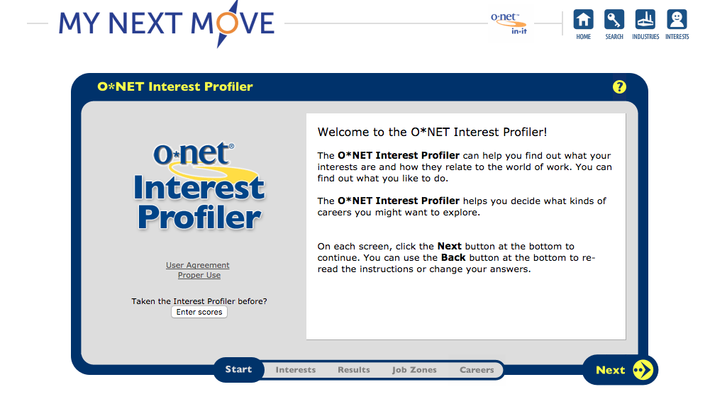
Notes:
Teacher Notes:
Materials needed: Students will need individual access to O-Net online
Talking Points:
There are many ways to research and learn about careers you are interested in. During the 8th grade and high school, you will take assessments and career interest resources will be provided for you to learn more about careers.
This website will always be available to you – From 8th grade through adulthood.
Let’s look at an example career and the information the website supplies.

Slide 6


CAREER
Environmental Compliance Inspector
Education required: 75% of these occupations require a four-year bachelor’s degree, 15% requires an Associate Degree, 10% requires High School Diploma
Schools: Western Kentucky University, Sullivan University, UK, U of L
Potential employers: Government, Finance & Insurance, Manufacturing, Healthcare
Job prospects: 5 to 8% job growth (Faster than average)
Job locations: Anywhere
Salary range: $43,790 to $123,710
Notes:
Teacher Notes:
Materials needed: Students will need individual access to O-Net online
Recommended Strategy: Pull up the O-Net website and search “Environmental Compliance Inspector”. Show the students how to find the information for each topic listed on the slide.
Talking Points:
Talk through Education, Schools, Employers, Job Prospects, Locations, and Salary for Environmental Compliance Inspector.

Slide 7



https://www.onetonline.org/
Notes:
Teacher Notes:
Materials needed: Career Interest Graphic Organizer & internet device for each student
Talking Points:
Using your internet browser, pull up the O-NET website. Give me a “thumbs up” once you’re there.

Slide 8


RESEARCH
What career do you want to explore?
What education does the career require?
What is the salary range for this career?
What is the predicted growth for this career and where are the jobs located?
Who would you work for? (Potential Employers)
What other information do you know about this career?
Notes:
Teacher Notes:
Materials needed: Career Interest Graphic Organizer & Piece of Paper
Complete a 1-2-3 exit slip on your piece of paper.
Answer the three questions on the screen about the career that you researched today.
What is one thing you learned? What are two questions you still have?
What are three action steps you can take to prepare for this career?
Make sure to write your name on your paper before turning it in.

Slide 9



1-2-3
EXIT SLIP
WRITE REFLECTION
1. What is one thing that you learned?
2. What are two questions that you still have?
3. What are three action steps you can take to prepare for this career?
Notes:
Teacher Notes:
Materials needed: Career Interest Graphic Organizer & internet device for each student
Talking Points:
You now have the opportunity to research a career that interests you on the O-NET website.
If you don’t know of a career to research, think back to completing your ILP (Individual Learning Plan).
What career did you find that you might be a good fit for?
Find this information about your chosen career and record your information on the Career Interest Graphic Organizer

